Slide 1


AUTOMATION
IN
WAREHOUSES
USING RASPBERRY PI

Slide 2



K.SOLOMON JONES

Slide 3

AUTOMATION
Automation is the process where the minimal or reduced human effort is used.
WAREHOUSE
Storage place where stocks or goods are stored.

Slide 4
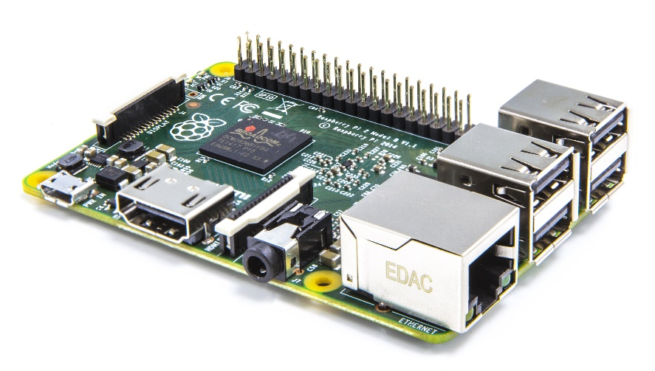
Raspberry pi
Raspberry is the mini size CPU.
Generally used for doing electronics projects.

Slide 5
Why Raspberry pi ?
It is cheap $35 USD.
It has inbuilt Ethernet port and Wi-fi .
It is easy to learn.
It has 26 input/output pins.
So for automating we need to use sensors.

Slide 6
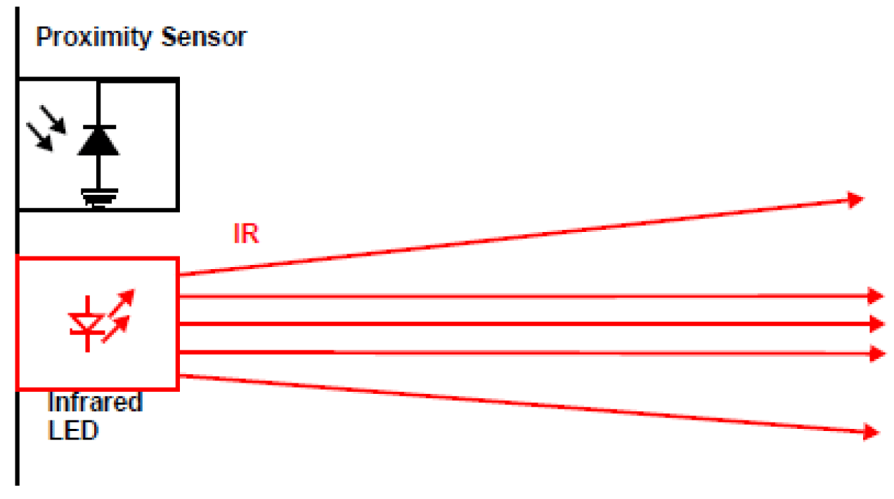
Infrared sensor

Slide 7
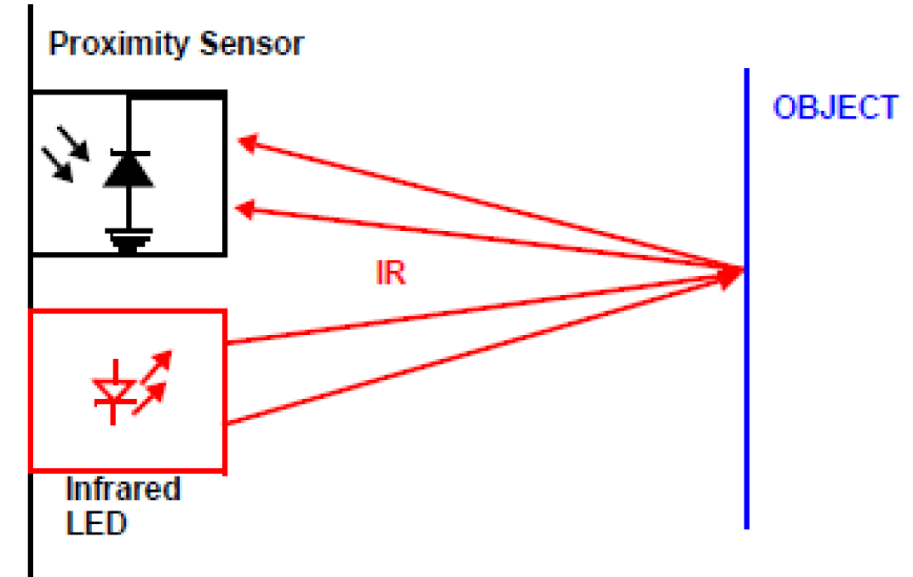
Infrared sensor

Slide 8
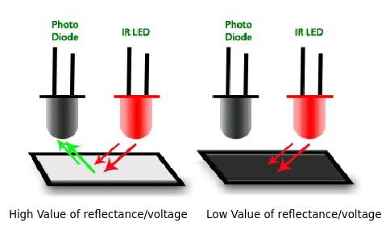
Infrared sensor

Slide 9
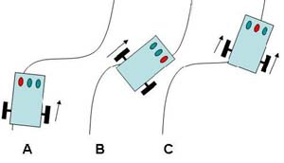
Infrared sensor

Slide 10
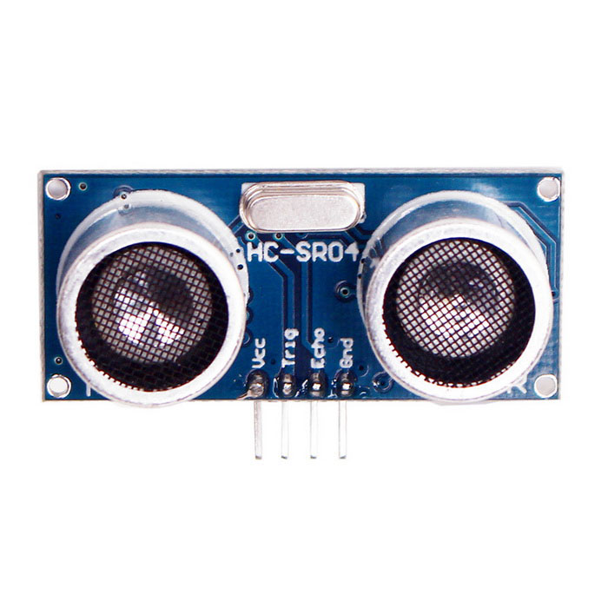
Ultra sonic sensor

Slide 11
Ultra sonic sensor
Speed of sound in air is = 343 m/s
Distance Travelled = 2*Distance
.’. Distance Travelled = 343* Time/2
Speed =Distance Travelled/Time taken
.’. Distance Travelled = 171.5 * Time

Slide 12
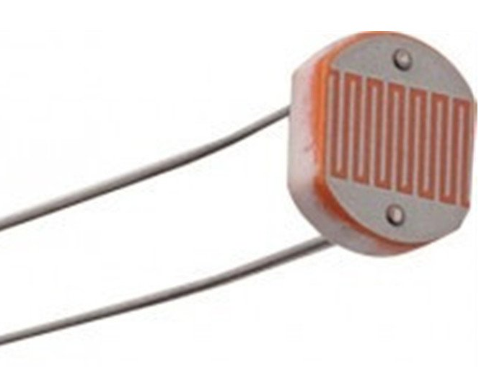
ldr sensor

Slide 13
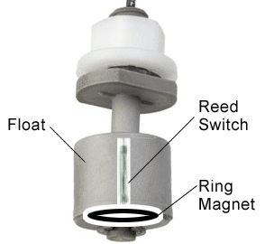
Float sensor

Slide 14
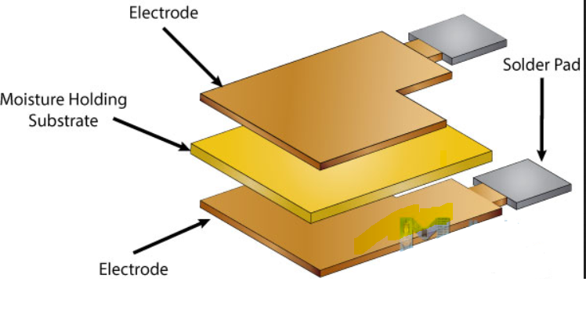
Temp and moist sensor

Slide 15
There are thousands of sensors

Slide 16
Not only these sensors.
There are thousands of sensors in the world

Slide 17
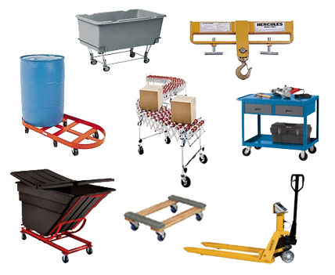
In Warehouses we use many material handling equipment’s like:
jib cranes,pallet trucks,dollies,drum equipments etc..
Most of these equipment’s are manually operated.

Slide 18
So by using the Raspberry Pi as the controller we can automate them and using the sensors. High voltages are operated using the Relays .

Slide 19
conclusion
The Automation in Warehouses using the Raspberry pi is the future Technology for the Automation . We can connect many sensors parallely and we can monitor them using IoT Technology from any part of the world.

Slide 20
K.SOLOMON JONES

Slide 21


